Slide 1


Predicting
Useful Reviews On Yelp Dataset
BA 576-400 Data and Text Mining Spring 2021
Group 2: Eunjeong Heo, Hyomin Shin, Yi-Jen Chiang, Yu-Kai Chen
Notes:
https://www.digitalexaminer.com/just-say-no-fake-online-reviews/
https://www.yext.co.uk/products/network/yelp/

Slide 2
Table of Content
01
Introduction
Presented by Hyomin Shin
02
Data Exploration
Presented by Yi-Jen Chiang
03
Data Preprocessing
Presented by Eunjeong Heo
04
Text Mining & Evaluation
Presented by Eunjeong Heo
05
Business Implications
Presented by Hyomin Shin
06
Further Extensions
Presented by YuKai Chen
Notes:
Introduction
Data Preprocessing
Text mining & evaluation
Business Implications
Further Extensions

Slide 3


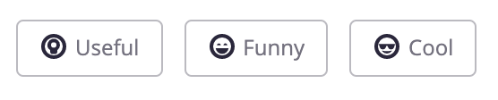



Introduction
Business Problem
1
Useful Vote
Lack of useful reviews
- Lack of participation
- Some businesses does not have any useful votes
1. Enhance User Experience
Slow pace of becoming useful
2. Prevent from fake reviews
or untrustworthy reviews
- Takes more time (weeks or months)
to be revealed as useful review
Notes:
https://www.yelp.com/biz/bonchon-metreon-san-Francisco

Slide 4





Introduction
Business Problem & Importance of Predicting the Likelihood of being Useful or Not
1
Users
Businesses
29% purchase on same day, 89% purchase on same week when viewing reviews
Lack of useful reviews
Reviews have big impact on purchase decision
Difficult to identify the main factors
that drives revenue
Lack of useful reviews
Cannot get relevant, reliable recommendation
Cannot make precise decision making
Updates of businesses operations may not be applied
(ex. current status of an employee or a menu)
Hard to gain insights, and information
to implement on business strategies

Slide 5



Data Exploration
Exploration of Original Datasets
2
Important Datasets
“yelp_review” | “yelp_business” | “yelp_user”
5,261,608 rows
9 columns
174,134 rows
13 attributes
174,134 rows
13 attributes
Notes:
To define and predict the useful reviews, the important datasets that needed in this reports are 'yelp_review, 'yelp_business', and 'yelp_user' datasets. We also try to find out the correlation between the useful review and location or other variables. For instance, funny, cool reviews, business review count, business stars and review stars.
Icon cite:
Review Free Icon. Review Free Icon of Marketing (Outline) icon set. (n.d.). https://icon-icons.com/icon/review/152110.
Shop Free Icon. Shop Free Icon of iOS7 Minimal Icons. (n.d.). https://icon-icons.com/icon/shop/4001.
Accounts, group, people, user, group, users Free Icon. Accounts, group, people, user, group, users Free Icon of General Web Elements. (n.d.). https://icon-icons.com/icon/accounts-group-people-user-group-users/113923.

Slide 6
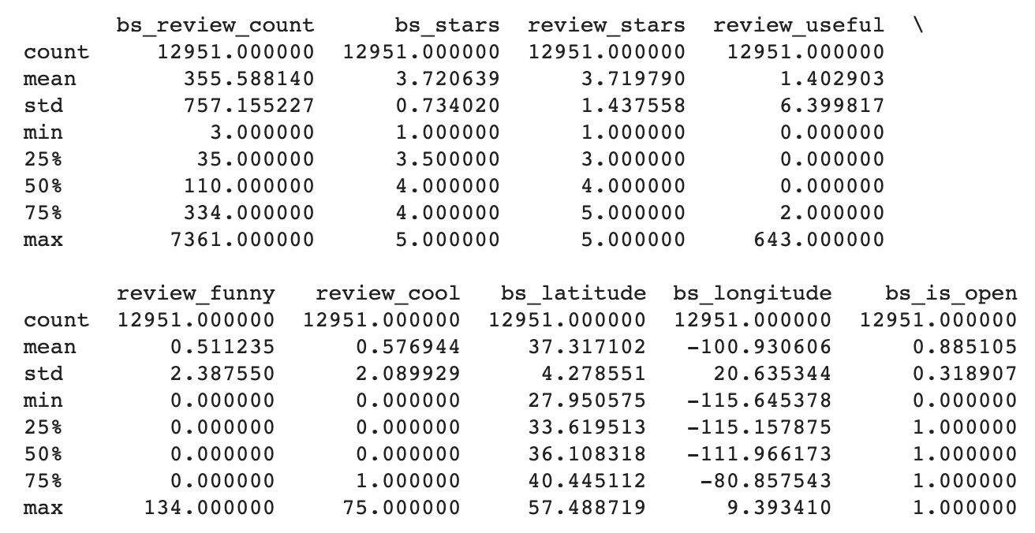

Data Exploration
Merging and Sampling Datasets Summary Statistics
2
Overall Summary Statistics
Notes:
To find out about the sample dataset, we summarized the attributes by summary statistics. Through exploring the summary, our team identified the values of mean, std, min, max and median in the data and whether the data is skewed or not.
Icon cite:
Statistics, charts, analysis, analytics, data Free Icon. Statistics, charts, analysis, analytics, data Free Icon of Design field. (n.d.). https://icon-icons.com/icon/statistics-charts-analysis-analytics-data/153186.

Slide 7
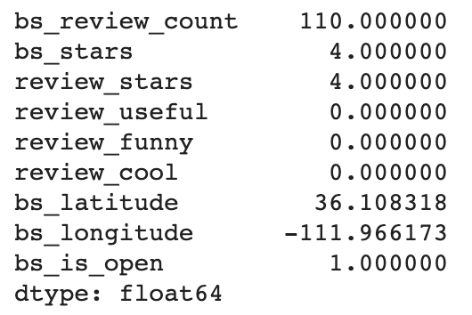
Data Exploration
Merging and Sampling Datasets Summary Statistics
2
Summary Statistics (Median)
Notes:
In addition, looked at the median for each attribute. We discovered that the review_useful had a median value of 0. This indicated that data mainly had the value of 0 and data may be skewed to the zero.
Icon cite:
Statistics, charts, analysis, analytics, data Free Icon. Statistics, charts, analysis, analytics, data Free Icon of Design field. (n.d.). https://icon-icons.com/icon/statistics-charts-analysis-analytics-data/153186.

Slide 8
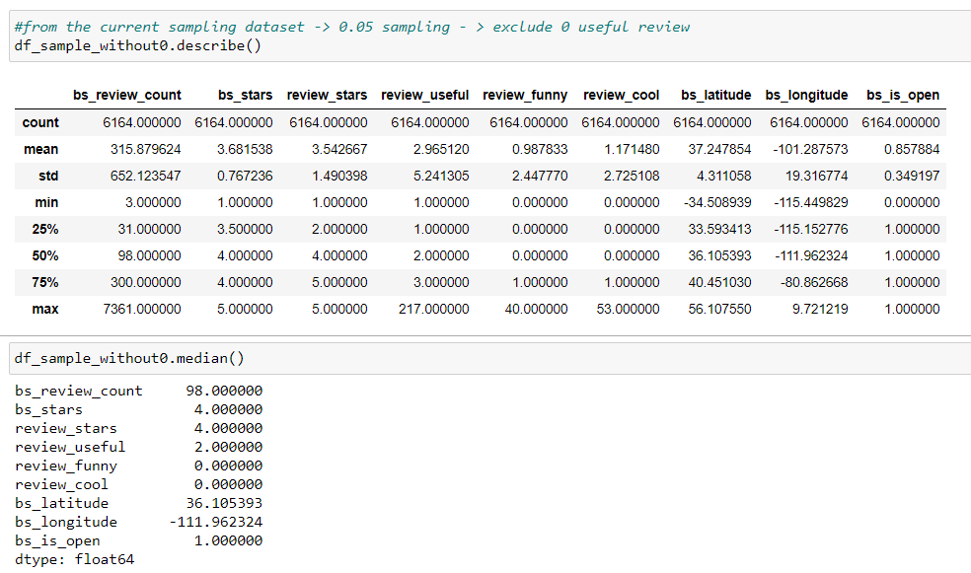
Data Exploration
Summary Statistics Excluding the Value ‘0’ for Useful
2
review_useful Summary Statistics with 0 votes
review_useful Summary Statistics excluded 0 votes
median
median 2.000000
Notes:
In order to examine it deeply, we decided to exclude the reviews with zero votes of useful attributes and compare the summary statistics outcome with previous statistics that included the value of zero. Through this way to define the criteria for the text mining process.

Slide 9
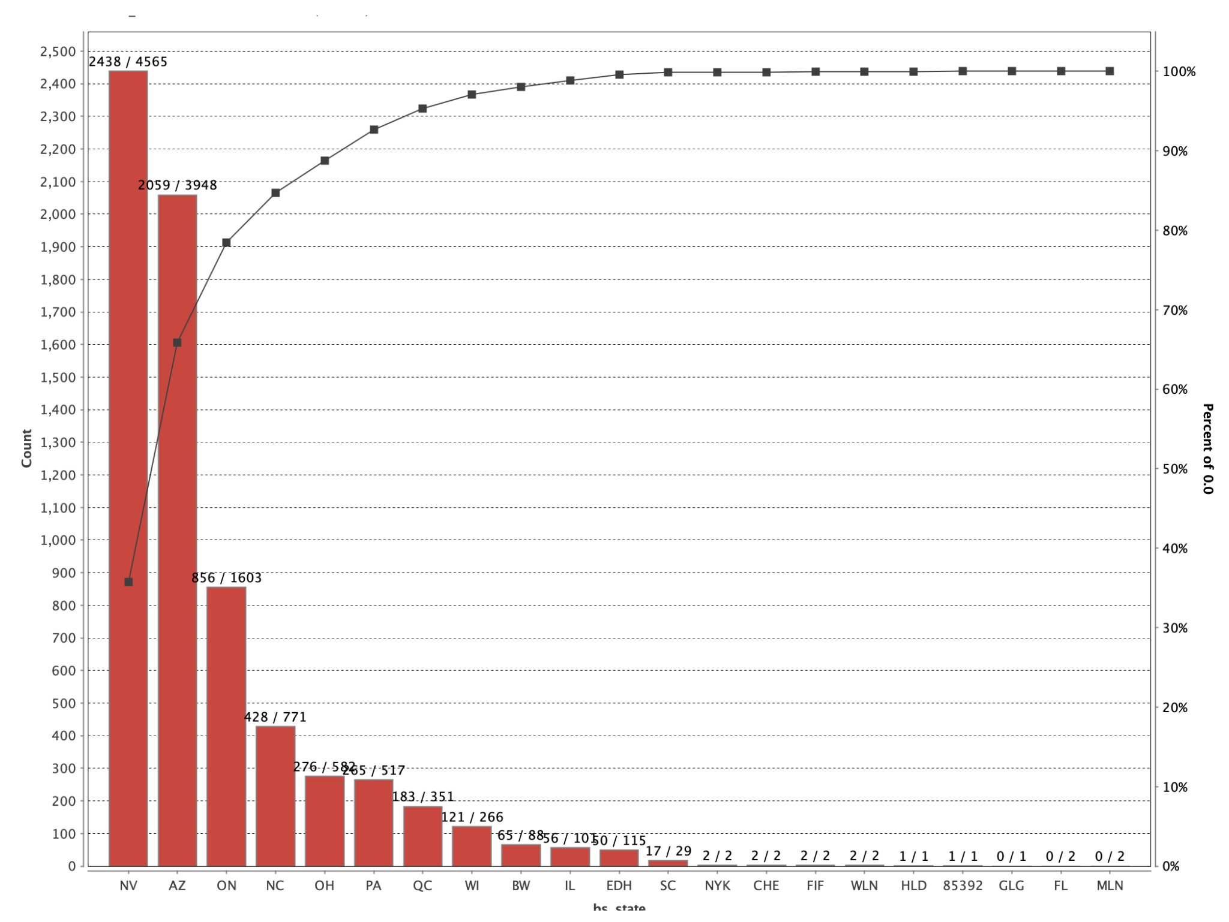

Data Exploration
Exploration on Location
2
The Total Amount of Reviews where Useful Vote is ‘0’ by Each State
All states have evenly distributed with about the same ratio of 5:5 to reviews
0 USEFUL votes
/
Over zero USEFUL votes
No Need to narrow down to specific area
Notes:
Our project further explored the relationship with useful attribute and the location to decide whether to limit the location to a specific area or not. The figure indicates that all states have evenly distributed with about the same ratio of 5 to 5 to reviews that have zero useful votes and have over zero useful votes. Therefore, there is no need to narrow down to a specific area.
https://icon-icons.com/icon/bulb-idea-light/74600

Slide 10
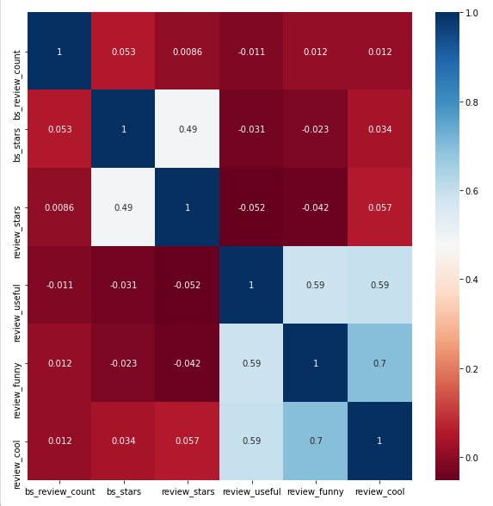
Data Exploration
Run Regression Model
2
Notes:
We further try to find out the correlation between useful reviews and other attributes, so our team run a regression model. The regression analysis result shows that funny and cool variables’ relationships being positive, however, it is not strongly correlated. Therefore, our group concluded that for the project, we should focus on the review text and useful attributes in the review dataset.

Slide 11


Data Preprocessing
3-1. Data Merging, Cleansing and Sampling
3
review
user
business
Dropping duplicates
& null values
13,000 independent observations
user_business_review.csv
Notes:
This is EunJeong, I’m going to present Data preprocessing, and text mining & evaluation part.
Our team initially decided to merge and sampling 3 datasets, ‘user’, ‘business’, and ‘review’, to see if there is more information we could obtain besides our main text data ‘review’. Therefore, the business and user data sets were merged into left-join, based on the review sample data set, then we dropped duplicates and null values using Python.
The 'sampling' process, which makes it as optimal input data, is a statistical procedure related to the selection of individual observations. Sampling helps to make statistical inferences about the population and make the model to run much more efficient. As our group’s goal is to identify potential useful reviews, we concluded around 13,000 independent observations would be enough. (49 sec)

Slide 12

Data Preprocessing
3-2. Set a Criterion for a ‘Useful Review’
3
sample_dataset (12951)_mean.csv
1 : mean > =3
0 : mean < 3
Set a criterion
sample_dataset (12951)_median.csv
1 : median >= 2
0 : median < 2
Data Exploration
‘user_business_review.csv’
sample_dataset (12951)_std.csv
1 : std >=5
0 : std < 5
Notes:
After exploring the data, to generate a training dataset, we concluded there are 3 different potential criterias to identify useful reviews which are mean, median and standard deviation. As there were too many 0 ‘useful votes’ in our dataset, we excluded them first to prevent diluting the criteria of useful reviews and generated 3 different binary criteria datasets as follows. In here, 1 represents useful reviews and 0 represents not useful, based on each data set’s defined criteria. (33 secs)

Slide 13
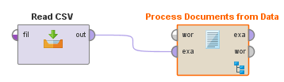
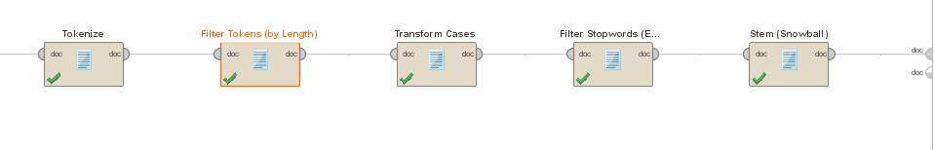
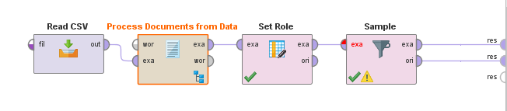
Data Preprocessing
3-3. Text Preprocessing and Under Sampling
3
Prune (3, 500)
TF-IDF
min char: 3, max char: 25
Under sampling
(2000, 2000)
Notes:
In the text preprocessing part, we pruned the text because it helped the dataset to improve acquiring the more meaningful text. Then, applied TF-IDF vector creation, which is a method to calculate how often a particular word appears in a whole document.
Under the embedded process of ‘Process Documents from Data’ operator, we initially ran ‘Tokenization’, ‘filter stopwords’, ‘Transform Cases’, ‘Filter Tokens' (by length’), and ‘Stem’ operators. ‘Filter Tokens (by POS)’ was excluded as the process took more than 10 minutes to complete.
The given dataset has much more class of 0 than 1 which typically results in degraded performance of the learned model due to the dominant influence of the observed category of data. Therefore, we undersampled the given data set by matching the number of samples based on the low-rate data value by using the operator ‘Sample’. (51sec)

Slide 14

Text Mining & Evaluation
Model Evaluation Criterion
4
Evaluation
1000
1000
1
0
Accuracy
Balanced data
Unbalanced data
Precision and Recall
F1-score
Under-sampled dataset
‘sample_dataset (12951)_mean.csv’
Notes:
Now, let’s move on to the text mining and evaluation part. Normally, accuracy is the most intuitive measure for evaluating classification models. Accuracy is most used when all the classes are equally important. However, when the data is unbalanced, precision, recall and F1-score could be better. The given dataset has the imbalanced data between class 1 and 0 in 1:5 ratio. However, in our case, we are classifying ‘useful’ and ‘not useful’ that are equally important because not only predicting ‘useful reviews’ brings extra profit by preparing the strategy, but also mis-classified ‘not useful reviews’ could cause a financial damage by ruining yelp user’s experience. Therefore, in the preprocessing stage, we undersampled the imbalanced data because if the number of data between 1 and 0 is too large, only the learning model of the dominant class takes place. (51 sec)

Slide 15
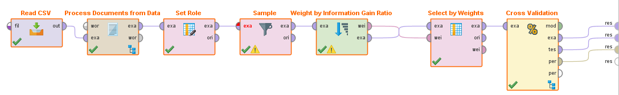
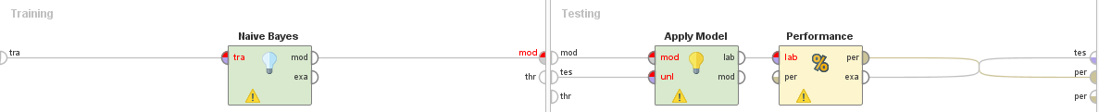
Text Mining & Evaluation
Model Improvement(1)
4
Under sampling (1000,1000)
Binary Term Occurrences
top k 3000
Notes:
We ended up using Naive Bayes algorithm with Binary Term Occurrences. It is simple, fast, and very effective, especially when training the model. It works well regardless of the size of the data, therefore, estimation probabilities for prediction could be easily obtained. At this point, we decided to use the ‘Weight by Information Gain Ratio’ operator with top k 3000 weight relation because it calculates the weight of attributes with respect to the label attribute by using the information gain ratio. The higher the weight of an attribute, the more relevant it is considered. (34 sec)

Slide 16
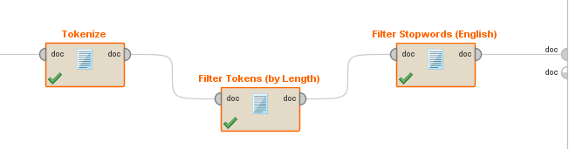
Text Mining & Evaluation
Model Improvement(2)
4
Why ‘Stemming’ and
‘Transform Cases’ are excluded?
(…) Jennifer was AMAZING! She was very kind and friendly and it was clear that it was genuine. She has earned a new customer. (…) She was great and I will be returning in four weeks. Thanks Jennifer!
(useful: 4, funny: 0, cool: 3)
WORST experience ever and RUINED MY LIFE!! No bedside manner. NONE! It's a MONEY MAKING SCAM! DO YOUR RESEARCH! (…) Just BEWARE! DO YOUR RESEARCH I WISH I HAD.
(useful: 12, funny: 2, cool: 0)
min char: 3, max char: 25
Notes:
Compared to the first phase of text pre-processing, ‘Transform Case’ and ‘Stem’ operators are excluded because for prediction models to identify useful reviews, ‘past tense’, ‘comparative’, ‘superlative’ or ‘capital letter’ do play a significant role. ‘Stemming’ and ‘Transform Cases’ could be useful such as identifying hot topics. In this case transforming all cases to one type and normalizing the same meaning words to one unified ‘Stem’ word might be more efficient to running the model. However, in our case, the reviews contain capital letters and different types of adjectives that presents unique patterns for useful reviews as follows:
As you see, some of the classified useful reviews emphasized their feelings with capital letters and used past tense to describe their experiences from the business. Furthermore, a lot of useful reviews used comparative or superlative adjectives such as ‘slower’, ‘smoother’, ‘lighter’, ‘heavier’, ‘greatest’, ‘worst’, etc. Therefore, if those features are eliminated by ‘stemming’ or ‘transform cases’ operators, the accuracy of the model decreases. (64sec)

Slide 17
Text Mining & Evaluation
Characteristic of Useful & Not-useful reviews
4
 | Useful | Not useful
Length | More than 1 paragraph | Shorter sentences
Contents | Detail-oriented experiences with taking specific examples | Not enough contents to understand the business
Expression | Frequent use of adjectives, comparatives and many exclamation marks | Monotonous explanation
Grammar | Less grammatical and spelling errors | More grammatical and spelling errors
Notes:
Based on our classified model, here is our general findings in characteristic of useful & not useful reviews. Gotten higher vote of useful reviews usually have more than 1 paragraph and the contents are very detail-oriented such as sharing specific personal experiences. Also, the useful reviews frequently use comparatives adjective with many exclamation marks and less grammatical and spelling errors. On the other hand, not useful reviews do not contain meaningful descriptions as well as the length is too short to understand the business. Also, there are mare grammatical and spelling errors.
(40sec)

Slide 18
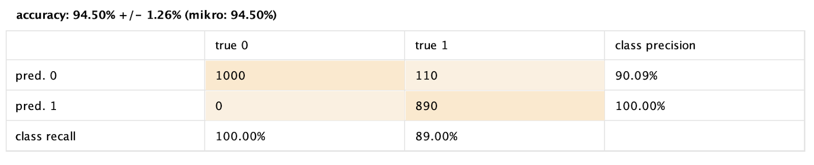
Text Mining & Evaluation
Accuracy of the model
4
Notes:
To this end, we created an Yelp review mining with the Naive Bayes algorithm with 94.5% of accuracy. Through this modeling we were able to present four categories that identified the features of useful reviews based on the classified results. Although the information obtained is limited, the model proposed a unique feature of useful reviews, and this feature could open a door for further algorithm development by setting more comprehensive classification criteria based on the project’s result. (31sec)

Slide 19


Business Implications
Implication for Users
5
Users
Facilitate efficient and effective purchasing decision-making process
Findings
Find out whether a review will be useful or not
Utilize the findings for further prediction
Common Features of useful reviews
Differences between ‘useful’ and ‘non-useful’
Attain reliable and valuable reviews to trust on,
and make reasoned decision

Slide 20



Business Implications
Implications for Businesses and Both
5
For Both: Users, Businesses
Businesses
Yelp can create algorithm
for recommending potential
useful reviews based on
the findings
Optimize efficient and effective
business activities
Monitor and assess business competitive advantage and disadvantage by useful reviews
Build strategies by utilizing useful reviews
(ex. inventory management, quality control etc.,)
Findings
Used as
Criteria
Provide
informative reviews

Slide 21
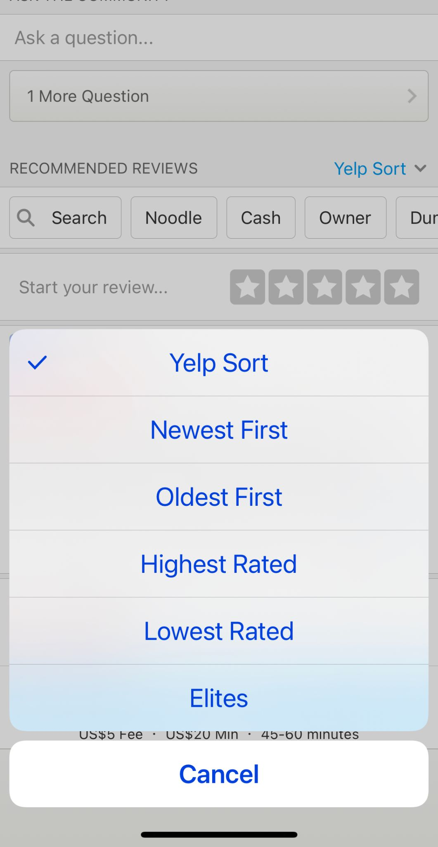



Further Extensions
Learning Based on the Article
6
Recommender and review sorting system are simple and limited.
Not effective for some users who want to sort by a specific criteria.
Price
Menu
Service

Slide 22
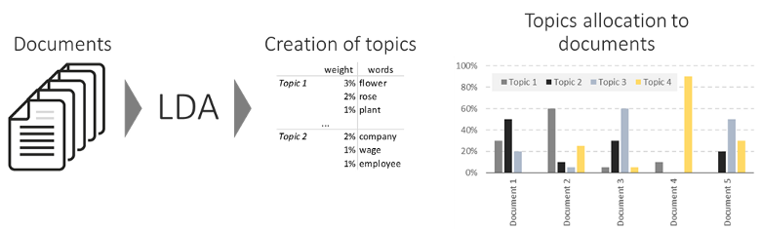
Further Extensions
Latent Dirichlet allocation (LDA)
6
Unsupervised machine-learning mode
LDA assigns a document to a mixture of topics
LDA needs to pre-identify how many headings

Slide 23
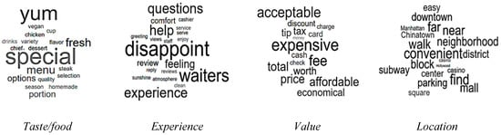
Further Extensions
Further Improvement (LDA)
6
Example for the restaurant category
The K value as 4 four aspects that need to be considered

Slide 24
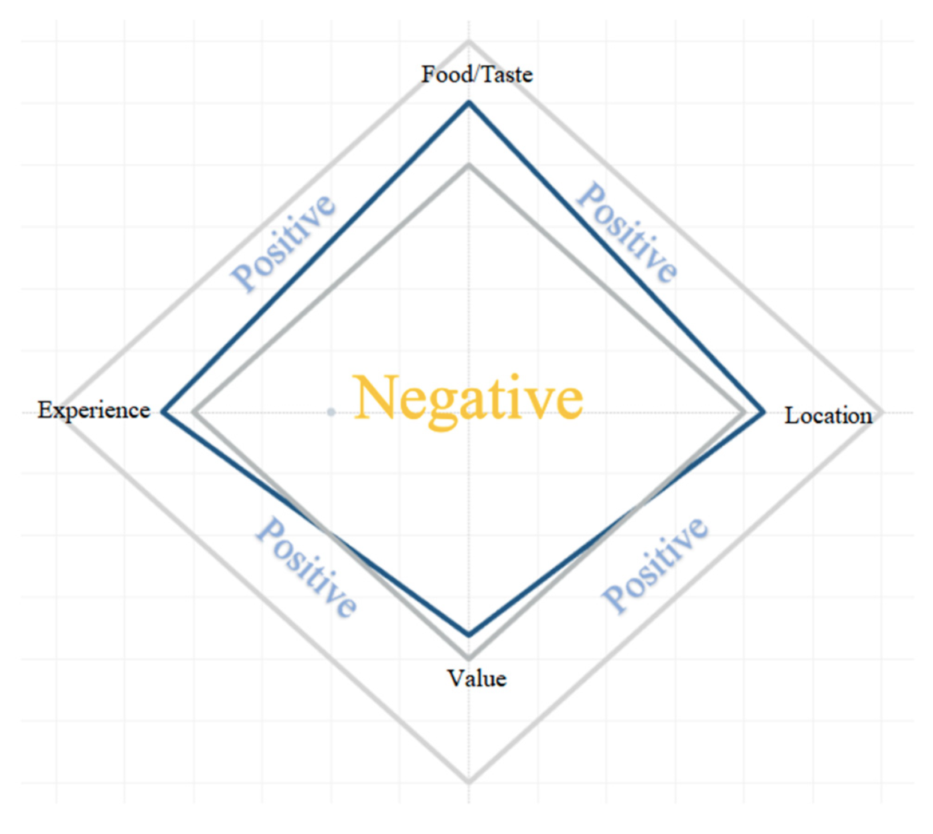
Further Extensions
Further Improvement (Sentiment Analyze)
6
Negative if it points is inner part of the diamond-shaped rectangle
Positive if it points is outside part of the diamond-shaped rectangle
User could sort by these aspects to see the review they want
Business could easily understand which aspect it needs to concern about

Slide 25
Reference
Image Source
Yelp Logo: https://www.yext.co.uk/products/network/yelp/
Slide #1 (Background image): https://www.digitalexaminer.com/just-say-no-fake-online-reviews
Slide #3 (Screenshot of useful votes): https://www.yelp.com/biz/bonchon-metreon-san-Francisco
Slide #20 (Yelp logo): https://en.wikipedia.org/wiki/Yelp
All of the icons used in the presentation slides are ‘Creative Commons Licenses’

Slide 26
Thank You
Group 2

